Slide 1
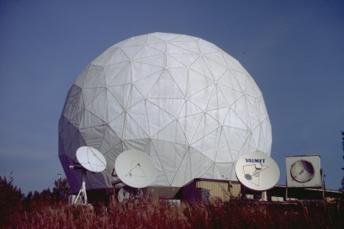
Connection between the parsec-scale radio jet and γ-ray flare in the blazar 1156+295
Venkatessh Ramakrishnan
Aalto University Metsähovi Radio Observatory, Finland
+
EVN Symposium 2014, Cagliari

Slide 2
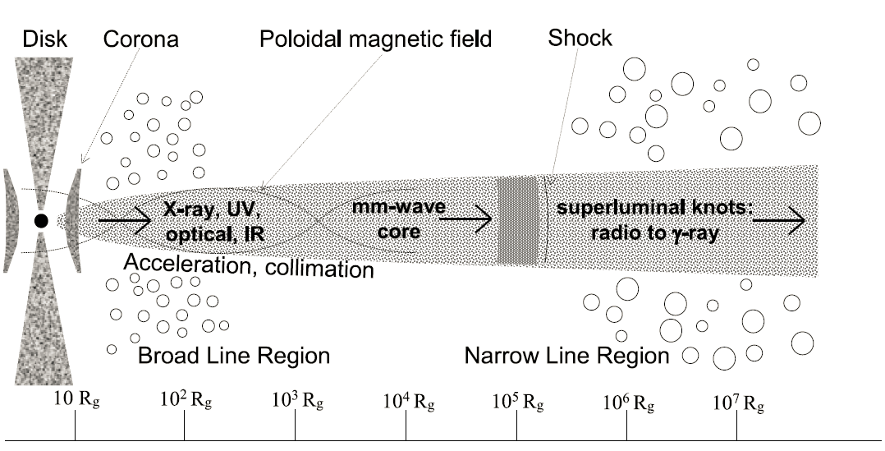
Importance of this work!
The γ-ray emission mechanisms of blazars are poorly understood
The location of the origin of the γ rays is uncertain
If close to the Black Hole / accretion disk, then source of electrons?
If downstream the radio core, source of photons?
Credit:
J. León-Tavares

Slide 3
The FSRQ 1156+295 (z ~ 0.729)
It has one-sided radio jet on mas scale
Variability on intraday (Savolainen & Kovalev 2008) and longer time scales (Hovatta et. al. 2009) have been discussed
Detected by CGRO/EGRET (Sreekumar et al (1996))
Long term optical variability in the blazar was reported by Fan et al (2006)

Slide 4
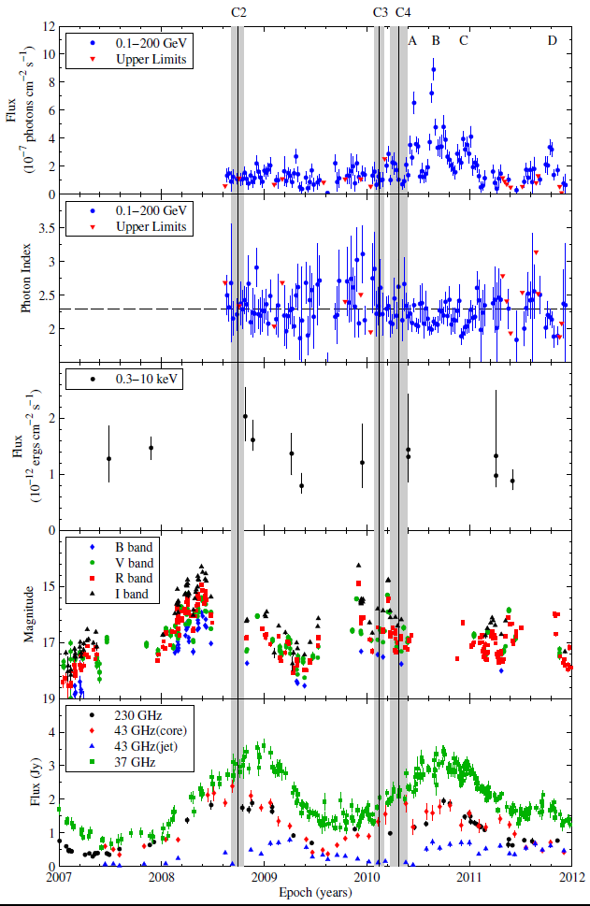
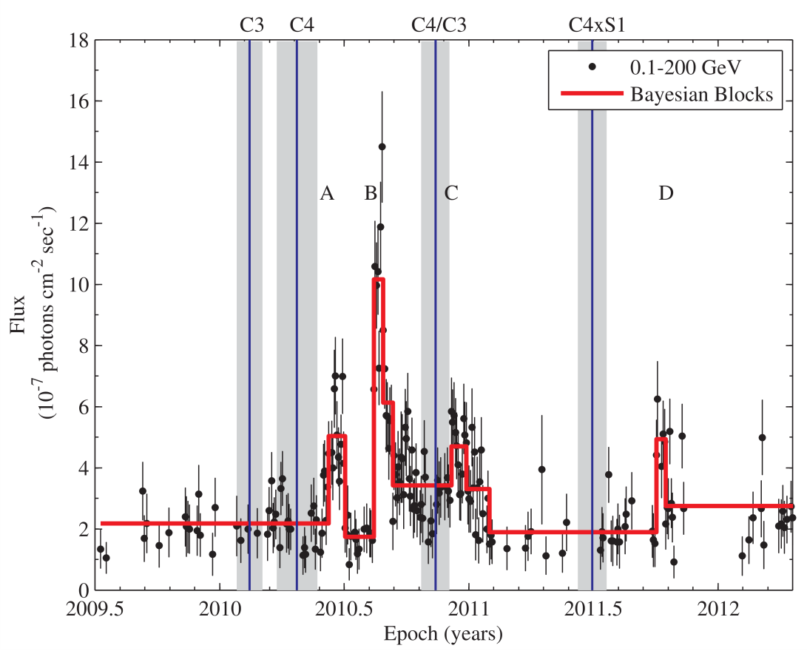
Multifrequency light curves from
2007-2012
Fermi/LAT 0.1-200 GeV
Multiple flaring states in γ rays
Flare and sub-flares have different
variability time scales (8-20 days)
Swift/XRT 0.3-10 keV
Under-sampled X-ray data
Metsähovi (37 GHz) and SMA
(230 GHz) along with 43 GHz VLBA
Exponential rise/decay in
mm-waveband
Orphan mm-flare?
CRTS, Lowell, Calar Alto, Liverpool,
Crimea & St. Petersburg State Univ.
Gaps in optical due to solar
conjunction

Slide 5
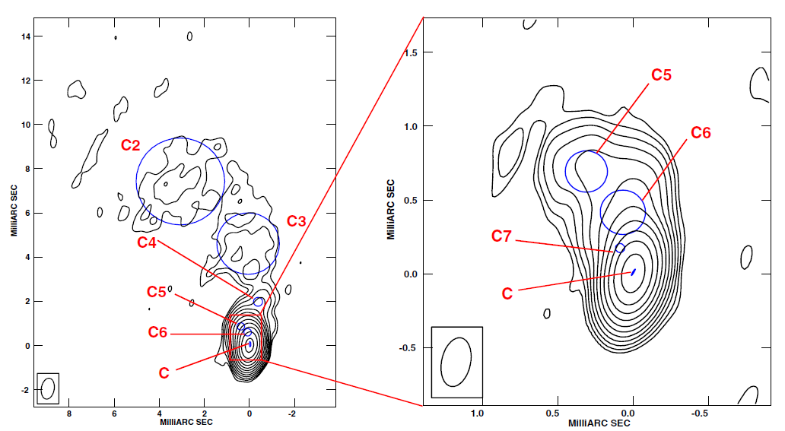
Jet Kinematics
Northerly jet - relativistically beamed towards us (θ < 2°),
Southern jet - becomes apparent only at distances > 2arcsec when it bends to the line of sight
Core-jet structure on pc-kpc scales
Helical trend using K-H instability
Zhao et al. (2011)

Slide 6
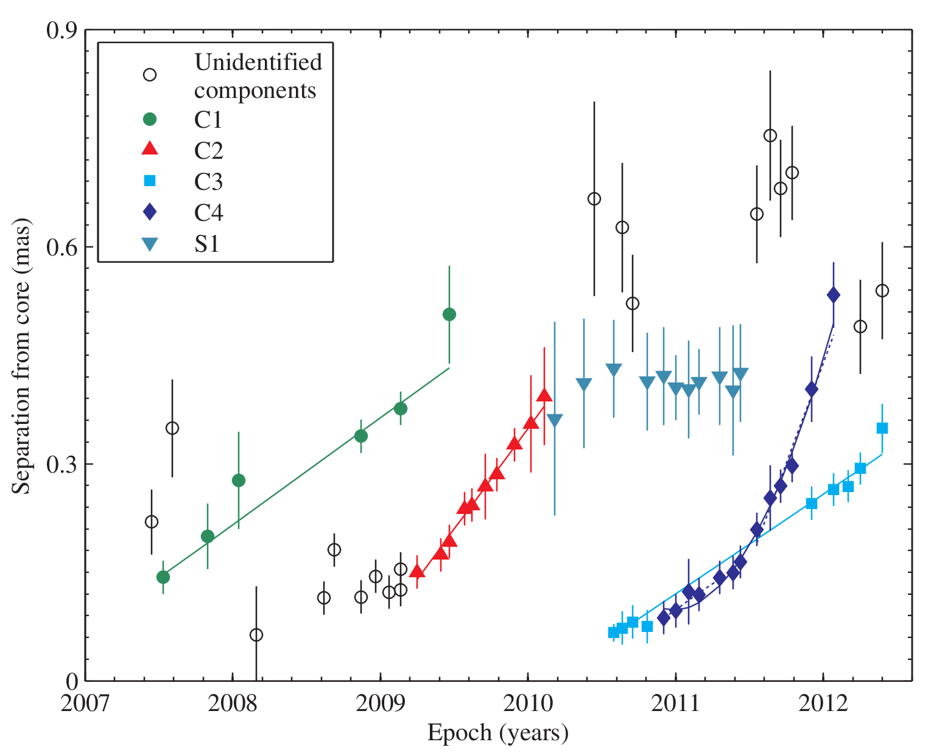
Boston University blazar
monitoring programme at
43 GHz with VLBA
(resolution ~ 0.15 mas)
47 VLBA epochs
4 moving & 1 stationary
component identified
All moving components except
C4 propagates linearly, while C4
accelerates beyond ~0.2 mas
Scale: 1mas = 7.26 pc

Slide 7
 | C1 | C2 | C3 | C4ª | C4^{b}
μ (mas yr⁻¹) | 0.147 ± 0.02 | 0.278 ± 0.01 | 0.137 ± 0.005 | 0.142 ± 0.05 | 0.552 ± 0.08
T_{o} (year) | 2006.53 ± 0.12 | 2008.74 ± 0.06 | 2010.12 ± 0.05 | 2010.31 ± 0.08 | ~2011.4
β_{app} | 6.18 ± 0.8 | 11.69 ± 1.5 | 5.76 ± 0.4 | 5.97 ± 0.8 | 23.22 ± 2.3
δ_{var} | 10.85 ± 1.5 | 18.54 ± 2.3 | 7.9 ± 0.3 | 15.37 ± 1.7 | 45.95 ± 2.1
Γ_{var} | 7.23 ± 1.4 | 12.98 ± 2.1 | 6.13 ± 1.2 | 8.8 ± 0.5 | 28.85 ± 1.4
Θ_{var} | 4.56 ± 0.3 | 2.79 ± 0.4 | 6.83 ± 0.4 | 2.52 ± 0.2 | 1 ± 0.08
ª before acceleration
^{b} after acceleration
Average size of core: 0.05 ± 0.004 mas
Average viewing angle: 3.5°

Slide 8
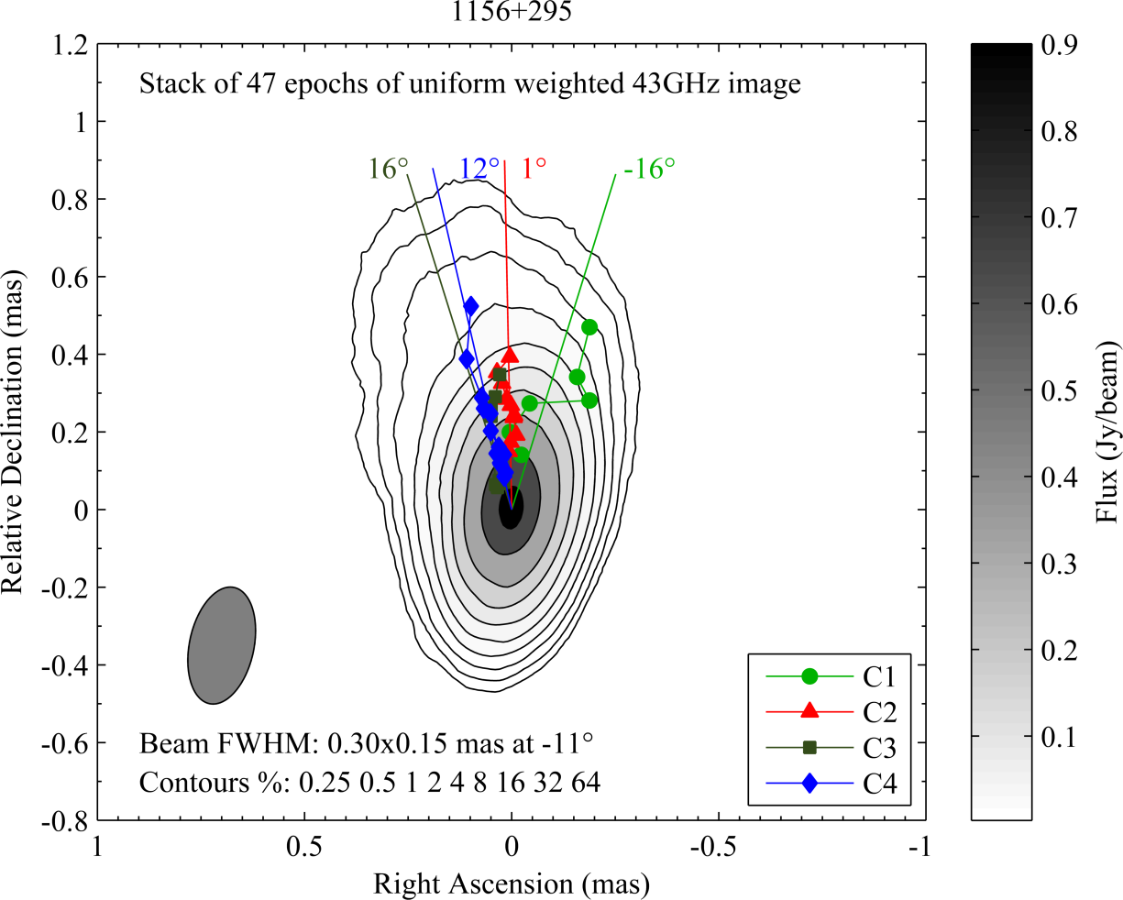
Perspective of Shocks
Component C4 – Forward/ reverse or
trailing shock?

Slide 9
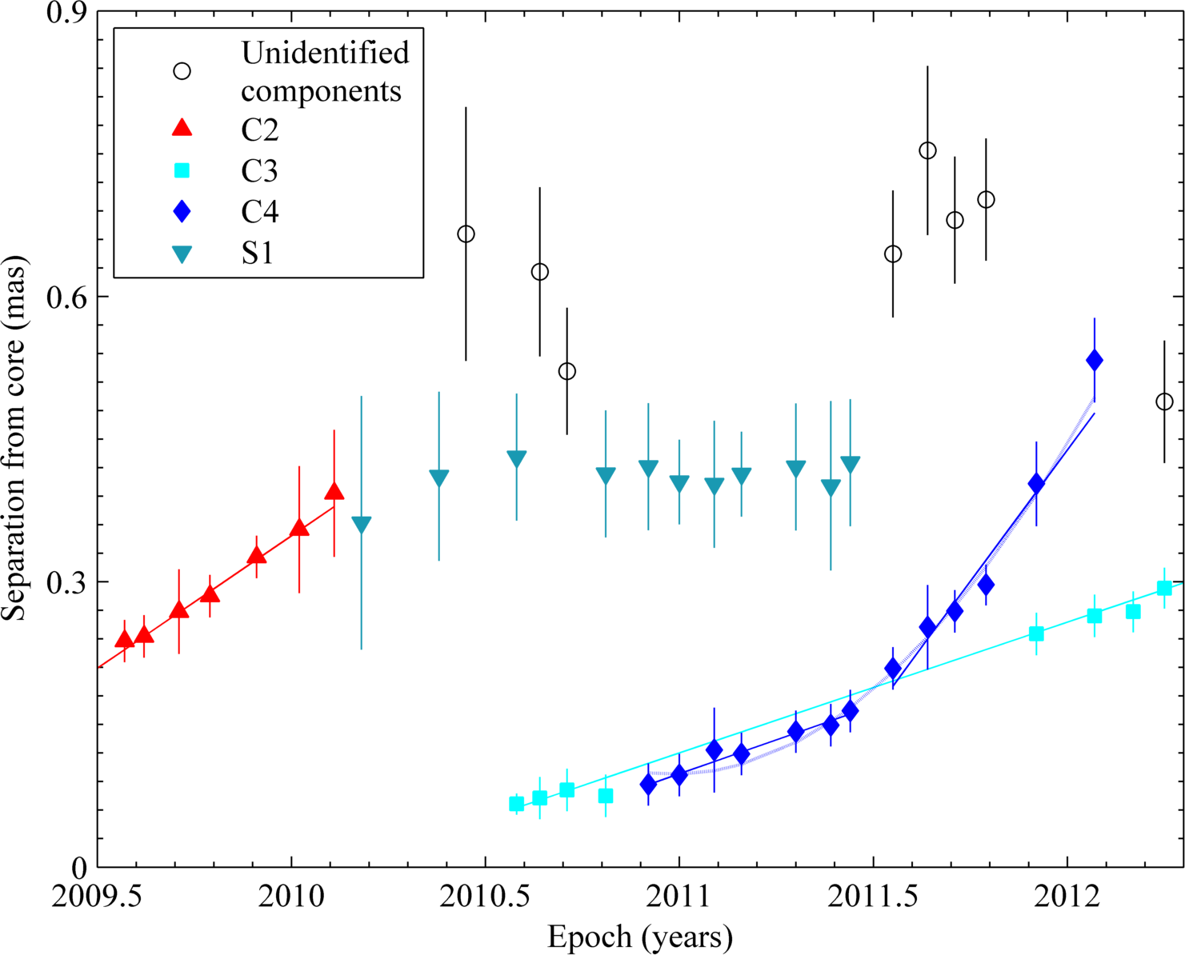
Radio / γ-ray connection
Component C3 - ejected before any γ-ray activity
Component C4:
ejected before any γ-ray activity (if from radio core)
ejected from C3 coinciding with the active phase in the γ rays
Interaction of C4 with S1 around 2011.5 triggers the γ-ray sub-flare D by 2011.8

Slide 10
Radio / γ-ray connection
Absence of a break in γ-ray spectra (Harris et al. (2014))
Complex shocks required to produce γ-ray flares - radiative transfer modelling (Aller et al. (2014))
absent during the orphan mm-flare

Slide 11
Summary
Strong γ-ray activity found for almost an year with the brightest flare occurring ~2 months from component ejection
Four moving and one stationary components were identified from VLBA maps
Evidence of relativistic shocks and shock-shock interaction for trigerring the γ-ray activity (similar to Jorstad et al. 2001; Marscher et al. 2010; Schinzel et al. 2012)
Polarization analysis and SED modelling might further answer the physical conditions prevailing during the high-energy flares and their emission mechanisms
...Thank you

